Slide 1

Network Traffic Anomaly Detection System
Using Isolation Forest & Streamlit
Presented by:
Ansh Kedia (CT_CSI_DS_3294) | Data Science Intern | Celebal Summer Internship

Slide 2
Why this project ?
Cyberattacks and abnormal network behavior are increasing.
Traditional detection systems are often rule-based and rigid.
We need scalable, unsupervised, real-time anomaly detection.
Objective
Detect Suspicious Activities: Identify outliers and abnormal patterns in network traffic data without requiring prior labels.
Enable Real-time Interaction: Allow users to upload custom CSV data and instantly receive visualized anomaly detection insights.
Ensure Simplicity & Accessibility: Build the system using lightweight, deployable frameworks like Streamlit, requiring no advanced technical setup.
Deliver Actionable Insights: Provide clear output through:
Anomaly tables
Summary statistics
Interactive scatter plots and charts
Encourage Scalability: Lay the groundwork for future integration with live traffic logs, APIs, and advanced models like Autoencoders or LSTM.

Slide 3
Tech Stack
Category | Tools Used
📊 ML Model | Isolation Forest (scikit-learn)
🌐 Frontend | Streamlit
🧪 Notebook | Jupyter Notebook
📦 Language | Python
📁 Storage | CSV & Pickle
Model Used
Isolation Forest
Works by isolating observations using random trees
Efficient for high-dimensional datasets
No need for labeled data
Output: -1 (Anomaly), 1 (Normal)

Slide 4
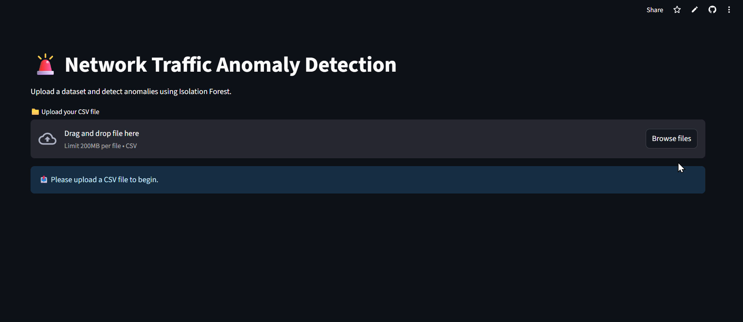
Visual Demo

Slide 5
Web App Functionality
Upload any network dataset
Model runs in real-time
Results shown in a table
Dynamic scatter plot and bar chart
Stats: Total vs. Anomalies count
Sample Output
Graph with anomalies highlighted
Bar chart showing anomaly %
Table: ID, Duration, Protocol, Anomaly Score, Label

Slide 6
Live Demo
🔗 Deployed Link: https://csiproject-vc244cqlgipvxqjn4wfb8y.streamlit.app/
📁 GitHub Repository: https://github.com/anshkedia-04/CSI_PROJECT

Slide 7
Learnings
Real-world problem-solving with ML
Handling unsupervised models
Model deployment using Streamlit
Git/GitHub and teamwork during internship
Conclusion
Built a functional anomaly detection system
Successfully deployed with a user-friendly interface
A step toward safer and smarter networks

